Slide 1

INTRODUCTION TO MANAGEMENT

Slide 2

MANagement is…
Getting things done through people.
The process of achieving organizational goals by engaging in the four major functions of planning & decision-making, organizing & staffing, directing/leading, and controlling.
Identifying a “force”/group of people whose job is to direct the effort and activities of other people towards a common organizational objective.
The performance of conceiving and achieving desired results by means of group effort consisting of utilizing resources, that will determine the success and failure of an organization.

Slide 3
A Chinese Proverb
“If you are planning for one year – plant rice. If you are planning for ten years – plant trees. But if you are planning for 100 years – plant people!”

Slide 4
Engineering Management is…
The process of designing and maintaining an environment in which, individuals, working together in groups, efficiently accomplish organizational goals/objectives.
    Management applies to any kind of organization.
    It applies to all managers at all organizational levels.
    The aim of all managers is the same; to create a surplus.
    Managing is concerned with productivity, which implies effectiveness and efficiency.

Slide 5
Functions of Management
Planning & Decision-Making
  Involves selecting goals and objectives, as well as the actions to achieve them; it requires decision-making, that is choosing the “best” from among alternatives.
Organizing
  Involves establishing an intentional structure of roles for people to fill in an organization.
  The process of allocating and arranging human and non-human resources so that plans can be carried out successfully.
Staffing
  Involves filling, and keeping filled, the positions in the organization structure.
  Process by which managers select, train, promotes, and retires subordinate.

Slide 6
Functions of Management
Directing/Leading
  Influencing people so that they will contribute to organizational and group goals.
Controlling
  Measuring and correcting individual and organizational performance to ensure that events conform to plans
  Facilitates the accomplishment of plans.
  The process of regulating organizational activities so that actual performance conforms to expected organizational standards.

Slide 7
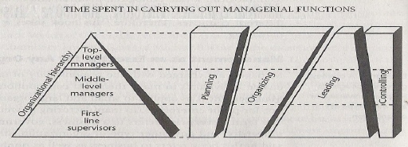
Managerial Functions and the Organizational Hierarchy

Slide 8
Managerial Levels
TOP
Strategic Managers who are ultimately responsible for the entire organization. Typical titles include CEO, COO, CFO, “President”, “Executive Vice President”, “Executive Director”, “Senior Vice President”, or “Vice President”.
MIDDLE
Tactical Managers located beneath the top levels of the hierarchy who are directly responsible for the work of managers at lower levels. Titles include “Manager”, “Director of”, “Chief”, “Department Head”, and “Division Head”.
FIRST-LINE
Operational Managers at the lowest level of the hierarchy who are directly responsible for the work of operating (non-managerial) employees. Often have titles that include the word “Supervisor”.

Slide 9
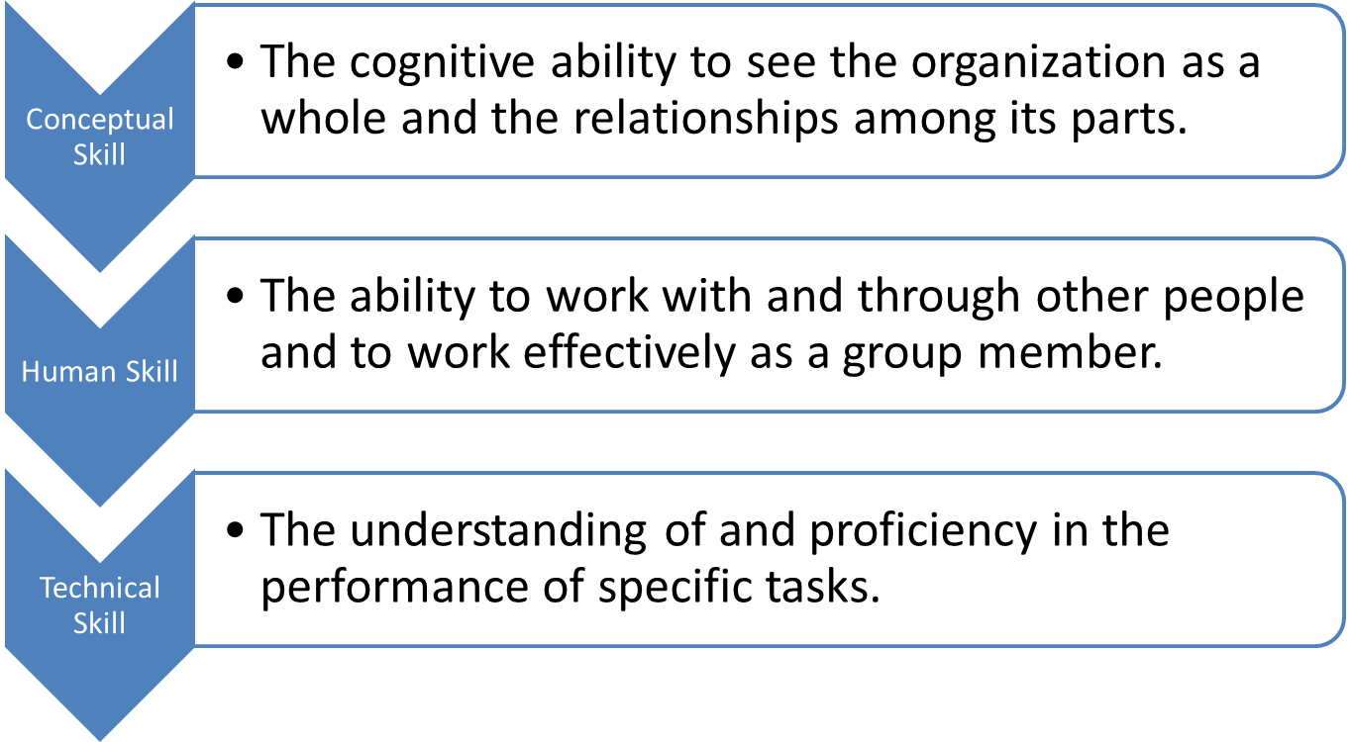
Management Skills

Slide 10
Management Skills and Levels
Top Management
Conceptual and design skills
Middle Management
Human skills
Technical skills
Supervisors
Percentage of job

Slide 11
What Managers Actually Do?
Unrelenting Pace
  Managers began working the moment they arrived at the office in the morning and kept working until they left at night. (e.g. Rather than taking coffee breaks they usually drank their coffee while they attended meetings, lunches were almost eaten in the course of formal of informal meetings.
Brevity, Variety, and Fragmentation
  Managers handled a wide variety of issues throughout the day. (e.g. Awarding a retirement plaque to discussing the bidding on a multi-million-dollar contract.
Verbal Contacts and Networks
  Managers showed a strong preference for verbal communication and relied heavily on networks. A network is a set of cooperative relationships with individuals whose help is needed in order for a manager to function effectively.

Slide 12
Do you really want to become a manager?
Here are some of the issues would-be managers should consider before deciding they want to pursue a management career:
The increased workload.
  It isn’t unusual for managers to work 70-80 hours per week, and some work even longer hours. A manager’s job always starts before a shift and end hours after the shift is over.

Slide 13
Do you really want to become a manager? (cont’d)
The challenge of supervising former peers.
  This issue can be one of the toughest for new managers.
  They frequently struggle to find the right approach, with some trying too hard to remain “one of the gang”, and others asserting their authority too harshly.
  In almost all cases, the translation from a peer-to-peer relationship to a manager-to-subordinate one is challenging and stressful.

Slide 14
Do you really want to become a manager? (cont’d)
The headache of responsibility for other people.
  A lot of people get into management because like the idea of having power, but the reality is that many managers feel overwhelmed by the responsibility of hiring, supervising, and disciplining others.

Slide 15
Do you really want to become a manager? (cont’d)
Being caught in the middle.
  Except for those in the top echelons, managers find themselves acting as a backstop, caught between upper management and the workforce.
  Even when managers disagree with the decisions of the top executives, they are responsible for implementing them.

Slide 16
Other Management Aspects
Characteristics of excellent and most admired managers.
Productivity, Effectiveness, and Efficiency.
Managing – Science or Art?
History/Evolution of Management Thought.

Slide 17
Excellent managers are/have
good communicator
acquire the skills of listening, speaking, reading, and writing
integrity
“living it myself before leading others”
flexible
multi-tasker, imaginative and innovative
focused
try to see the “big picture” within the forest of details
committed
willing to do whatever it takes attain organizational success
people-oriented
knows that people’s feelings are important
gratitude
“give credit where it is due”

Slide 18
Productivity, Effectiveness, and Efficiency
Productivity is an index that measures output (goods and services) relative to the input (labor, materials, energy, and other resources) used to produce them.
Effectiveness means the capability of producing an effect. (doing the "right" things)
Efficiency is a measure of how well a certain aspect is performing. (doing the things “right”)

Slide 19
Is Management a Science or an Art?
Definitions according to Webster's College Dictionary:
Art – “skill in conducting any human activity”
Science – “any skill or technique that reflects a precise application of facts or a principle”

Slide 20
The Evolution of Management Theory
Began in the industrial revolution in the late 19th century as:
    - Managers of organizations began seeking ways to better satisfy customer needs.
    - Large-scale mechanized manufacturing began to adopt small-scale craft production in which goods were produced.
    Social problems were developed in the large groups of workers employed under the factory system.
    Managers began to focus on increasing the efficiency of the worker-task mix.

Slide 21
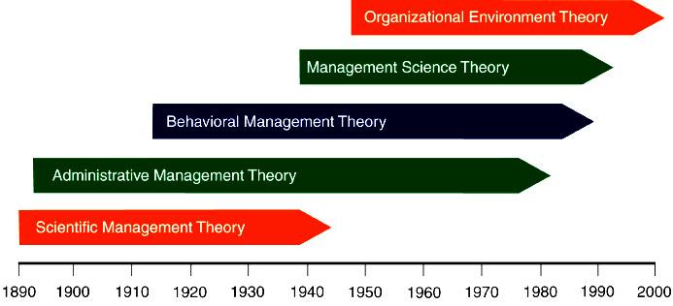
The Evolution of Management Theory

Slide 22
The Evolution of Management Theory
Adam Smith (18th century economist)
  Observed that firms manufactured pins in one of two different ways:
    Craft-style - each worker did all steps.
    Production - each worker specialized in one step.
  Realized that job specialization resulted in much higher efficiency and productivity
    Breaking down the total job allowed for the division of labor in which workers became very skilled at their specific tasks.

Slide 23
The Evolution of Management Theory
Frederick Winslow Taylor
  “Father "of Scientific Management (systematic study of the relationships between people and tasks for the purpose of redesigning the work process for higher efficiency”) in the late 1800’s to replace informal rule of thumb knowledge.
  Taylor sought to reduce the time a worker spent on each task by optimizing the way the task was done.

Slide 24
The Evolution of Management Theory
Taylor’s Four Principles of Scientific Management
Scientifically study each part of a task and develop the best method for performing it.
Carefully select workers and train them to perform the task using the scientifically developed method.
Cooperate fully with workers to ensure that they use the proper method.
Divide work and responsibility so that management is responsible for planning work methods using scientific principles and workers are responsible for executing the work accordingly.

Slide 25
The Evolution of Management Theory
Frank and Lillian Gilbreth
  Refined Taylor’s work and made many improvements to the methodologies of time and motion studies.
  Time and motion studies
    Breaking up each job action into its components.
    Finding better ways to perform the action.
    Reorganizing each job action to be more efficient.
  Also studied worker-related fatigue problems caused by lighting, heating, and the design of tools and machines.

Slide 26
The Evolution of Management Theory
Max Weber
  Developed the concept of bureaucracy as a formal system of organization and administration designed to ensure efficiency and effectiveness.

Slide 27
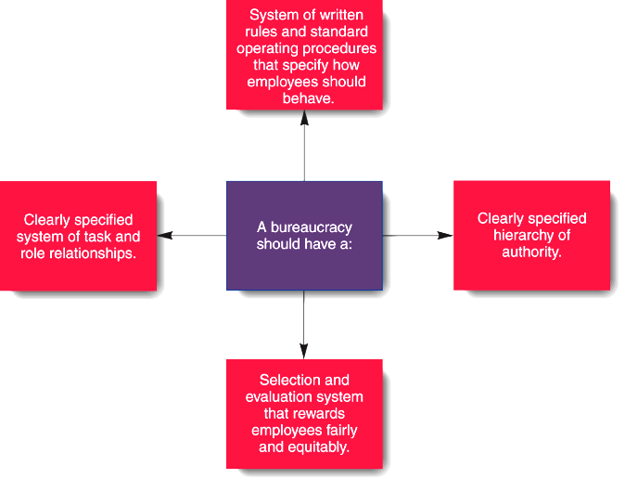
The Evolution of Management Theory
Weber’s Principle of Bureaucracy

Slide 28
The Evolution of Management Theory
Weber’s Five Principles of Bureaucracy
Authority is the power to hold people accountable for their actions.
Positions in the firm should be held based on performance, not social contacts.
Position duties are clearly identified so that people know what is expected of them.
Lines of authority should be clearly identified such that workers know who reports to who.
Rules, standard operating procedures (SOPs), and norms guide the firm’s operations.

Slide 29
The Evolution of Management Theory
Henri Fayol
  Synthesized various tenets or principles of organization and management
  He published "The Principles of Scientific Management" in the USA in 1911

Slide 30
The Evolution of Management Theory
Fayol’s 14 Principles of Management
1. Division of work – divide work into specialized tasks and assign responsibilities to specific individuals.
2. Authority – delegate authority along with responsibility.
3. Discipline – make expectations clear and sanction violations.
4. Unity of command – each employee should be assigned only to one supervisor.
5. Unity of direction – employees’ efforts focused on achieving organizational objectives.

Slide 31
The Evolution of Management Theory
Subordination of individual interest to the general interest – the general interest must predominate.
Remuneration – systematically reward efforts that supports the organization’s direction.
Centralization – determine the relative importance of superior and subordinate roles.
Scalar chain – keep communications within the chain of command.
Order – order jobs and material so they support the organization’s direction.

Slide 32
The Evolution of Management Theory
Equity – managers should be kind and fair to their subordinates .
Stability of tenure – management should provide orderly personnel planning and ensure that replacements are available to fill vacancies.
Initiative – employees who are allowed to originate and carry out plans will exert high levels of effort .
“Esprit de corps” – promoting team spirit will build harmony and unity within the organization.

Slide 33
Approaches to Management
Empirical or Case Approach
  Studies experience through cases.
  Identifies successes and failures.
Contingency or Situational Approach
  Managerial practice depends on circumstances (i.e., a contingency or a situation).
  Contingency theory recognizes the influence of given solutions on organizational behavior patterns.
Mathematical or “Management Science” Approach
  Sees managing as mathematical processes, concepts, symbols, and models.
  Looks at management as a purely logical process, expressed in mathematical symbols and relationships.
Decision Theory Approach
  Focuses on the making of decisions, persons or groups making decisions, and the decision-making process.
  Some theorists use decision making as a springboard to study all enterprise activities. The boundaries are no longer clearly defined.

Slide 34
Approaches to Management
Re-engineering Approach
  Concerned with fundamental re-thinking, process analysis, radical re-design, and dramatic results.
Systems Approach
  Systems have boundaries, but they also interact with the external environment; that means organization are open systems.
  Recognizes the importance of studying interrelatedness of planning, organizing, and controlling in an organization as well as in the many subsystems.
Socio-technical Approach
  Technical system has a great effect on the social system (personal attitudes, group behavior).
  Focuses on production, office operations, and other areas with close relationships between the technical system and people.

Slide 35
Approaches to Management
Group Behavior Approach
  Emphasizes behavior of people in groups.
  Based on sociology and social psychology.
  Primarily studies group behavior patterns.
  The study of large groups is often called organizational behavior.
Interpersonal Behavior Approach
  Focuses on interpersonal behavior, human relations, leadership, and motivation.
  Based on individual psychology.
Cooperative Social Systems Approach
  Concerned with both interpersonal and group behavioral aspects leading to a system of cooperation.
  Expanded concept includes any cooperative group with a clear purpose.

Slide 36
Approaches to Management
McKinsey’s 7-S Framework
  The seven S’s are (1) strategy, (2) structure, (3) systems, (4) style, (5) staff, (6) shared values, and (7) skills.
Total Quality Management Approach
  Focuses on providing dependable, satisfying products and services (Deming) or products or services that are fit for use (Juran), as well as conforming to its quality requirements (Crosby).
Management Process or Operational Approach
  Draws together concepts, principles, techniques, and knowledge from other fields and managerial approaches.
Managerial Roles Approach
  Original study consisted of observations of five chief executives.
  On the basis of this study, ten managerial roles were identified and grouped into interpersonal, informational, and decision roles.

Slide 37
The Managerial Roles Approach:
Managerial Roles
    Interpersonal Roles – grow directly out of the authority of a manager’s position and involve developing and maintaining positive relationships with significant others.
    2. Informational Roles – pertain to receiving and transmitting information so that manager can serve as the nerve centers of their organizational units.
    3. Decisional Roles – involve making significant decisions that affect the organization.

Slide 38
10 Specific Managerial Roles
Interpersonal Roles
Role | Description
Figurehead | Performs symbolic duties of a legal or social nature.
Leader | Builds relationships with subordinates and communicates with help and information.
Liaison | Maintains networks of contacts outside work unit who provide help and information.

Slide 39
10 Specific Managerial Roles
Informational Roles
Role | Description
Monitor | Seeks internal and external informational about issues that can affect organization.
Disseminator | Transmits information internally that is obtained form either internal or external sources.
Spokesperson | Transmits information about the organization to outsiders.

Slide 40
10 Specific Managerial Roles
Decisional Roles
Role | Description
Entrepreneur | Acts as initiator, designer, and encourager of change and innovation.
Disturbance Handler | Takes corrective action when organization faces important, unexpected difficulties.
Resource Allocator | Distributes resources of all types including time, funding, equipment, and human resources.
Negotiator | Represents the organization in major negotiations affecting the manager’s areas of responsibility.

Slide 41
Management Styles
Administrators
  Administrators look to company rules and regulations for solving all problems. They live by the book and are usually very good employees. They show total loyalty to the organization and have probably been with the company for many years.
  Administrators are usually not very good communicators, using the official company channels for all communications, which are often limited to one level upwards and downwards.
  They are not good in resolving conflict, looking to company rules for resolving these. In spite of their rather mechanistic approach.
  They are generally respected by their staff, and by peers, for their organizational loyalty and knowledge.

Slide 42
Management Styles
Time Servers
  These are generally older mangers who have lost interest in their job and environment, and are marking time until retirement or moving to another job.
  They take all necessary action to avoid stress, and maintain a low profile within the company.
  Although these mangers are not generally lazy, their low motivation means that they do the minimum amount of work needed to hold down a job.
  Decisions are avoided since they could lead to mistakes.
  Personal status is very important to them.
  Time servers usually have good management experience, and if motivated can become a very valuable asset to the organization.
  They often consider themselves to be “father or mother figures”.
  They understand people and can build an effective team if they try.
  They recognize achievements in others and are ready to acknowledge them.

Slide 43
Management Styles
Climbers
  These manager are driven by extreme personal ambition and will sacrifice everything, including self and family, to get to the top of the corporate ladder.
  They want to achieve and to be seen to have achieved, especially by those in a superior position.
  Climbers will pursue personal advancement by fair means or foul. However, they become demotivated if this does not show quick results, and this can eventually lead to stress.
  Self interests come before those of the organization, and peers will be fought in order to gain an advantage and to build an empire.
  Status is important but only as a sign of seniority.

Slide 44
Management Styles
Generals
  This is usually a younger person who exhibits lots of energy.
  The general likes to rule and manipulate power, but is achievement oriented: power is used to get tasks done.
  Generals work extremely hard, driving themselves and those around them.
  Generals are sociable and mix well at all levels. They usually get their way with peers by overwhelming, although peers can resent this if it is done too often.
  Status is important to generals, but for the luxury associated with it, not as a symbol of seniority.
  They are strong-willed individuals, often with the same characteristics as a self-made entrepreneurs.
  Usually they are optimistic about the future, sometimes wrongly.

Slide 45
Management Styles
Supporters
  Supporters maintain a balanced view about the world, the organization, subordinates, and themselves.
  They are usually experience managers who are knowledgeable in management techniques and apply them where they can.
  Supporters work through people in achieving their aims.
  They are good at delegation and develop their subordinates by giving them responsibility.
  The people working under them are highly motivated.
  Supporters’ personal technical knowledge is usually lacking, but this compensated for by the support they themselves receive from the specialists within their department.
  Supporters are good facilitators and are very good in managing change.
  They recognize achievement and reward it.
  They tend to be loners and do not mix well with peers.
  This means that they can often miss out on information from the grapevine, so that they are not always well-briefed on organizational matters.

Slide 46
Management Styles
Nice Guys
  These managers are usually weak-willed and are more interested in being liked, by peers and subordinates, than in achieving targets.
  They do not criticize their subordinates, even when they are poor performers, and may in fact support too much, so unconsciously retarding their development.

Slide 47
Management Styles
Bosses
  Bosses are extremely inflexible and are often mistaken for strong-minded people.
  Usually, they are only strong talkers, and hide behind abusive language.
  They try to terrorize subordinates and peers, creating conflict to emphasize their own power.
  Managers in the boss category are often brought into a company to act as “Hatchet Men”.
  In the short-term, they can show results, but in long-term they are very destructive, causing more harm than good.
  They are insecure in themselves and get security by humiliating others in public.
  They advance by pointing out the mistakes of others, and not by their own achievements.

Slide 48
Five Filipino Styles of Management
1. Managers by “Kayod”
  “Kayod” is a Filipino term which means “to sweat it out or to give oneself to hard work”.
  This manager is action-hungry, highly dedicated, but his manners are rather formal and that of an introvert.
  He is a serious worker and will not give in to bribing or any anomalous deals.
2. Managers by “Lusot”
  “Lusot” is another Filipino word which means “capitalizing on a loophole”.
  Thus, this manager will be always on the lookout for loophole of anything and will use them to avoid too much work, or shortcuts and to do unconventional or even illegal ways to attain objectives. Generally, an extrovert.
  He deals with people informally.
3. Managers by “Libro”
  “Libro” in English, book.
  This type of manger operates by the dictates of the book.
  What the manuals other formal documents say.
  He is systematic and analytical.
  He usually has adequate formal training in management.

Slide 49
Five Filipino Styles of Management
Managers by “Oido”
  This manager leaves his managerial skills by oido or by ear.
  He has a vast field of practical experiences to compensate for his lack of formal management education.
  He is the opposite of the “Libro” manager.
Managers by “Ugnayan”
  He is a hybrid of all type of managers.
  Hence, he is one type of manager now, and different in another time, depending on the situation.
  He is a gifted reconciler of all philosophers and beliefs held by various types of managers.
  He integrates various styles of management depending on the need and conditions of his organization.
  He is participatory and coordinative.
Reference : Management - A Global Perspective by Weihrich and Koontz 11th Edition
Management by Richard L. Daft, 8th Edition (2008)

